Slide 1
Sultan S. Alqahtani
Assistance Professor
PhD in Computer Science (Software Engineering)
ssalqahtani@imamu.edu.sa
Office: 3092

Slide 2
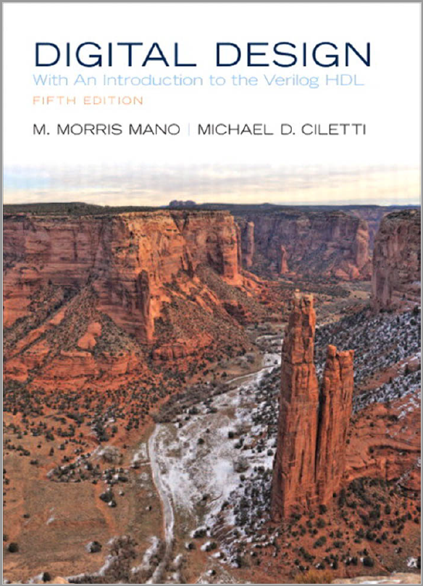
Course Information
Credit Hours | 3 credit hours Sun, Mon, Tue, and Wed from 10:00 to 11:50 am
Instructor | Name | Sultan Saud Alqahtani
 | Email | ssalqahtani@imamu.edu.sa
Textbook | Required | M. Morris Mano, “Digital Design,” Prentice Hall, 4th or 5th Edition.
Office hours | Mon from 12:30 to 14:20 pm

Slide 3
Grade Scheme
Grades
Quizzes 10%
Mid Term Exam 30%
Lab Exams 20% (TBD)
Final Exam 40%

Slide 4
Topics to be Covered
List of Topics | No. of Weeks | Contact hours
Digital Systems and Binary Numbers |  | 8
Boolean Algebra and Logic Gates |  | 12
Gate-Level Minimization |  | 8
Combinational Logic |  | 12
Synchronous Sequential Logic |  | 12
Registers and Counters |  | 8

Slide 5
Course Objectives
On completing this course, you shall :
Comprehend numbering systems and Boolean algebra and two-valued logic.
Learn about the digital logic primitives
Learn about design representation.
Learn formal methods to optimally manipulate the representations.
Learn about designs of basic modules.

Slide 6
Chapter 1
Digital Systems and Binary Numbers

Slide 7
Content
Digital Systems
Number Systems
Decimal, Binary, Octal, and Hexadecimal
Number-base Conversations
Arithmetic Operations
Complements of Numbers
Signed Binary Numbers
Binary Code
Binary Storage and Registers
Binary Logic

Slide 8
Digital Systems

Slide 9
Digital versus Analog
We live in an Analog world.
Analog means Continuous
We use the word Analog to express phenomena or parameters that have smooth gradual change or movement.
For example, earth’s movement around the sun is continuous or Analog.
Temperature is an Analog parameter. In making a cup of tea, the temperature of the tea increases gradually or smoothly.
In an Analog system, parameters have a continuous range of values

Slide 10
Digital versus Analog
The word Digital, however, means just the opposite.
In Digital Systems, parameters have a limited set of Discrete Values that they can assume.
In Other words, digital parameters don’t have a Continuous range.
This means that, digital parameters change their values by Jumping from one allowed value to another.
As an example, the day of the month is a parameter that may only assume one value out of a set of limited discrete values {1, 2, 3, …., 31}.

Slide 11
Digital versus Analog
Analog devices and systems process time-varying signals that can take on any value across a continuous range.
Analog Signal
Digital systems use digital circuits that process digital signals which can take on one of two values, we call:
0 and 1 (digits of the binary number system)
or LOW and HIGH
or FALSE and TRUE
High
Low
Digital Signal

Slide 12
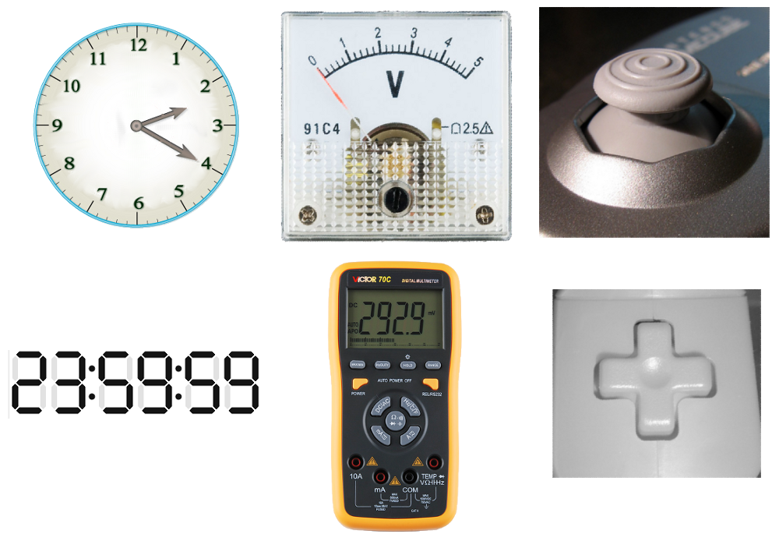
Analog vs. Digital
High
Low
Analog Signal
Digital Signal
Analog
Digital

Slide 13
A Simple Logic Design: Seven Segment Display
Chip to drive digital display
L1
L 4
L 6
L2
L 5
L 7
L3

Slide 14
Cont.
L1
L 4
L 6
L2
L 5
L 7
L3

Slide 15
Advantages of Digital Over Analog Sys.
Why digital?
digital systems are easier to design since dealing with a limited set of values rather than an infinite (or indefinitely large) continuous range of values is significantly simpler
information storage is easy
accuracy and precision is better
operation can be programmed
digital circuits are less affected by noise

Slide 16
Part 1
Number systems

Slide 17
Common Number Systems
System | Base | Symbols | Used by humans? | Used in computers?
Decimal | 10 | 0, 1, … 9 | Yes | No
Binary | 2 | 0, 1 | No | Yes
Octal | 8 | 0, 1, … 7 | No | No
Hexa- decimal | 16 | 0, 1, … 9, A, B, … F | No | No

Slide 18
Quantities/Counting (1 of 3)
Decimal | Binary | Octal | Hexa- decimal
0 | 0 | 0 | 0
1 | 1 | 1 | 1
2 | 10 | 2 | 2
3 | 11 | 3 | 3
4 | 100 | 4 | 4
5 | 101 | 5 | 5
6 | 110 | 6 | 6
7 | 111 | 7 | 7

Slide 19
Quantities/Counting (2 of 3)
Decimal | Binary | Octal | Hexa- decimal
8 | 1000 | 10 | 8
9 | 1001 | 11 | 9
10 | 1010 | 12 | A
11 | 1011 | 13 | B
12 | 1100 | 14 | C
13 | 1101 | 15 | D
14 | 1110 | 16 | E
15 | 1111 | 17 | F

Slide 20
Quantities/Counting (3 of 3)
Decimal | Binary | Octal | Hexa- decimal
16 | 10000 | 20 | 10
17 | 10001 | 21 | 11
18 | 10010 | 22 | 12
19 | 10011 | 23 | 13
20 | 10100 | 24 | 14
21 | 10101 | 25 | 15
22 | 10110 | 26 | 16
23 | 10111 | 27 | 17
Etc.

Slide 21
Conversion Among Bases
The possibilities:
Decimal
Octal
Binary
Hexadecimal

Slide 22
Quick Example
25₁₀ = 11001₂ = 31₈ = 19₁₆
Base

Slide 23
Decimal to Decimal (just for fun)
Decimal
Octal
Binary
Hexadecimal
Next slide…

Slide 24
Weight
125₁₀ => 5 x 10⁰ = 5 2 x 10¹ = 20 1 x 10² = 100 125
Base

Slide 25
Binary to Decimal
Decimal
Octal
Binary
Hexadecimal

Slide 26
Binary to Decimal
Technique
Multiply each bit by 2^{n}, where n is the “weight” of the bit
The weight is the position of the bit, starting from 0 on the right
Add the results

Slide 27
Example
Bit “0”
101011₂ => 1 x 2⁰ = 1 1 x 2¹ = 2 0 x 2² = 0 1 x 2³ = 8 0 x 2⁴ = 0 1 x 2⁵ = 32
43₁₀

Slide 28
Octal to Decimal
Decimal
Octal
Binary
Hexadecimal

Slide 29
Octal to Decimal
Technique
Multiply each bit by 8^{n}, where n is the “weight” of the bit
The weight is the position of the bit, starting from 0 on the right
Add the results

Slide 30
Example
724₈ => 4 x 8⁰ = 4 2 x 8¹ = 16 7 x 8² = 448 468₁₀

Slide 31
Hexadecimal to Decimal
Decimal
Octal
Binary
Hexadecimal

Slide 32
Hexadecimal to Decimal
Technique
Multiply each bit by 16^{n}, where n is the “weight” of the bit
The weight is the position of the bit, starting from 0 on the right
Add the results

Slide 33
Example
ABC₁₆ => C x 16⁰ = 12 x 1 = 12 B x 16¹ = 11 x 16 = 176 A x 16² = 10 x 256 = 2560
2748₁₀

Slide 34
Decimal to Binary
Decimal
Octal
Binary
Hexadecimal

Slide 35
Decimal to Binary
Technique
Divide by two, keep track of the remainder
First remainder is bit 0 (LSB, least-significant bit)
Second remainder is bit 1
Etc.

Slide 36
Example
125₁₀ = ?₂
2 125 62 1
2 31 0
2 15 1
2 7 1
2 3 1
2 1 1
2 0 1
125₁₀ = 1111101₂

Slide 37
Octal to Binary
Decimal
Octal
Binary
Hexadecimal

Slide 38
Octal to Binary
Technique
Convert each octal digit to a 3-bit equivalent binary representation

Slide 39
Example
705₈ = ?₂
7 0 5
111 000 101
705₈ = 111000101₂

Slide 40
Hexadecimal to Binary
Decimal
Octal
Binary
Hexadecimal

Slide 41
Hexadecimal to Binary
Technique
Convert each hexadecimal digit to a 4-bit equivalent binary representation

Slide 42
Example
10AF₁₆ = ?₂
1 0 A F
0001 0000 1010 1111
10AF₁₆ = 0001000010101111₂

Slide 43
Decimal to Octal
Decimal
Octal
Binary
Hexadecimal

Slide 44
Decimal to Octal
Technique
Divide by 8
Keep track of the remainder

Slide 45
Example
1234₁₀ = ?₈
8 1234
154 2
8
19 2
8
2 3
8
0 2
1234₁₀ = 2322₈

Slide 46
Decimal to Hexadecimal
Decimal
Octal
Binary
Hexadecimal

Slide 47
Decimal to Hexadecimal
Technique
Divide by 16
Keep track of the remainder

Slide 48
Example
1234₁₀ = ?₁₆
16 1234
77 2
16
4 13 = D
16
0 4
1234₁₀ = 4D2₁₆

Slide 49
Binary to Octal
Decimal
Octal
Binary
Hexadecimal

Slide 50
Binary to Octal
Technique
Group bits in threes, starting on right
Convert to octal digits

Slide 51
Example
1011010111₂ = ?₈
1 011 010 111
1 3 2 7
1011010111₂ = 1327₈

Slide 52
Binary to Hexadecimal
Decimal
Octal
Binary
Hexadecimal

Slide 53
Binary to Hexadecimal
Technique
Group bits in fours, starting on right
Convert to hexadecimal digits

Slide 54
Example
1010111011₂ = ?₁₆
10 1011 1011
B B
1010111011₂ = 2BB₁₆

Slide 55
Octal to Hexadecimal
Decimal
Octal
Binary
Hexadecimal

Slide 56
Octal to Hexadecimal
Technique
Use binary as an intermediary

Slide 57
Example
1076₈ = ?₁₆
1 0 7 6
001 000 111 110
2 3 E
1076₈ = 23E₁₆

Slide 58
Hexadecimal to Octal
Decimal
Octal
Binary
Hexadecimal

Slide 59
Hexadecimal to Octal
Technique
Use binary as an intermediary

Slide 60
Example
1F0C₁₆ = ?₈
1 F 0 C
0001 1111 0000 1100
1 7 4 1 4
1F0C₁₆ = 17414₈

Slide 61
Exercise – Convert ...
Decimal | Binary | Octal | Hexa- decimal
33
 | 1110101
 |  | 703
 |  |  | 1AF
Don’t use a calculator!
Skip answer
Answer

Slide 62
Exercise – Convert …
Answer
Decimal | Binary | Octal | Hexa- decimal
33 | 100001 | 41 | 21
117 | 1110101 | 165 | 75
451 | 111000011 | 703 | 1C3
431 | 110101111 | 657 | 1AF

Slide 63
Common Powers (1 of 2)
Base 10
Power | Preface | Symbol
10⁻¹² | pico | p
10⁻⁹ | nano | n
10⁻⁶ | micro | μ
10⁻³ | milli | m
10³ | kilo | k
10⁶ | mega | M
10⁹ | giga | G
10¹² | tera | T
Value
.000000000001
.000000001
.000001
.001
1000
1000000
1000000000
1000000000000

Slide 64
Common Powers (2 of 2)
Base 2
Power | Preface | Symbol
2¹⁰ | kilo | k
2²⁰ | mega | M
2³⁰ | Giga | G
Value
1024
1048576
1073741824
In computing, particularly w.r.t. memory, the base-2 interpretation generally applies

Slide 65
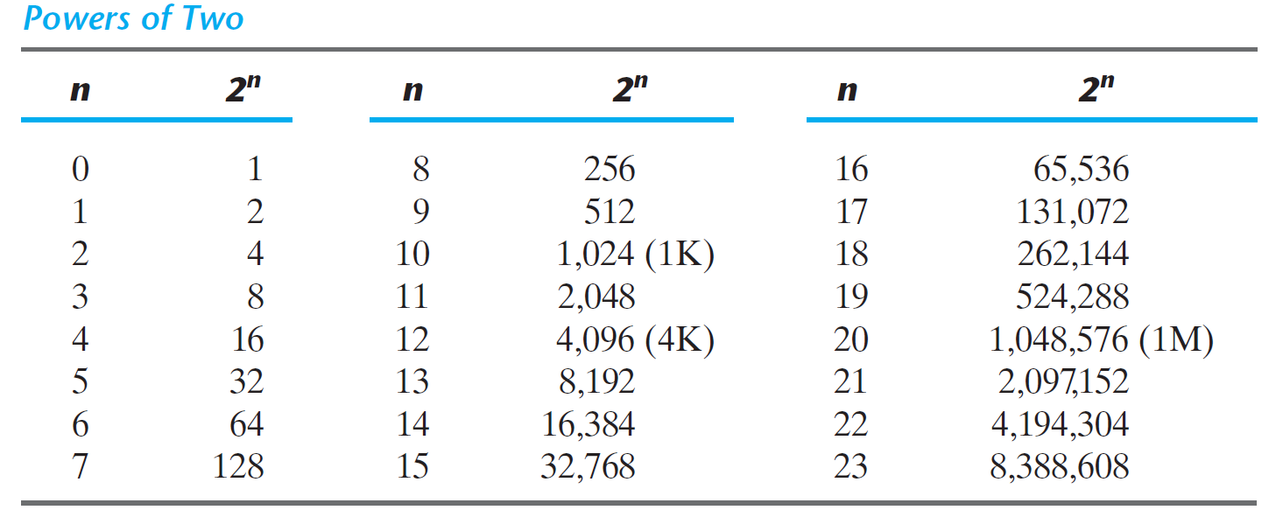

Slide 66
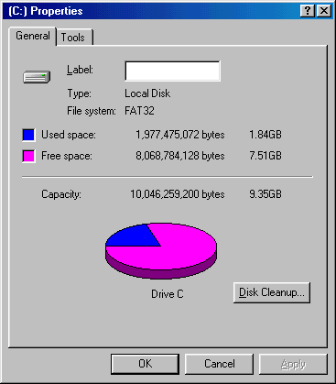
Example
/ 2³⁰ =

Slide 67
Fractions (Reading Ex.)
Decimal to decimal (just for fun)
3.14 => 4 x 10⁻² = 0.04 1 x 10⁻¹ = 0.1 3 x 10⁰ = 3 3.14

Slide 68
Fractions (Reading Ex.)
Binary to decimal
10.1011 => 1 x 2⁻⁴ = 0.0625 1 x 2⁻³ = 0.125 0 x 2⁻² = 0.0 1 x 2⁻¹ = 0.5 0 x 2⁰ = 0.0 1 x 2¹ = 2.0 2.6875

Slide 69
Fractions (Reading Ex)
.14579 x 2 0.29158 x 2 0.58316 x 2 1.16632 x 2 0.33264 x 2 0.66528 x 2 1.33056
etc.
Decimal to binary
3.14579
The conversion of decimal numbers with both integer and fraction parts is done by
converting the integer and the fraction separately and then combining the two answers.
11.001001...

Slide 70
Exercise – Convert ...
Decimal | Binary | Octal | Hexa- decimal
29.8
 | 101.1101
 |  | 3.07
 |  |  | C.82
Don’t use a calculator!
Skip answer
Answer

Slide 71
Exercise – Convert …
Answer
Decimal | Binary | Octal | Hexa- decimal
29.8 | 11101.110011… | 35.63… | 1D.CC…
5.8125 | 101.1101 | 5.64 | 5.D
3.109375 | 11.000111 | 3.07 | 3.1C
12.5078125 | 1100.10000010 | 14.404 | C.82

Slide 72
Part 2
Complements

Slide 73
Binary Addition (1 of 2)
Two 1-bit values
A | B | A + B
0 | 0 | 0
0 | 1 | 1
1 | 0 | 1
1 | 1 | 10
“two”

Slide 74
Binary Addition (2 of 2)
Two n-bit values
Add individual bits
Propagate carries
E.g.,
1
1
10101 21 + 11001 + 25 101110 46

Slide 75
Multiplication (1 of 3)
Decimal (just for fun)
35 x 105 175 000 35 3675

Slide 76
Multiplication (2 of 3)
Binary, two 1-bit values
A | B | A × B
0 | 0 | 0
0 | 1 | 0
1 | 0 | 0
1 | 1 | 1

Slide 77
Multiplication (3 of 3)
Binary, two n-bit values
As with decimal values
E.g.,
1110 x 1011 1110 1110 0000 1110 10011010

Slide 78
Complements
Complements are used for simplifying the subtraction operation and for easy manipulation of certain logical rules and events.
Two types of complements for each base-r system:
Radix Complement (r’s complement)
Diminished Complement ((r-1)’s complement)

Slide 79


Diminished Complement
 | r’s complement | (r – 1)’s complement
r = 10 | 10’s complement | 9’s complement
r = 2 | 2’s complement | 1’s complement
r = 8 | 8’s complement | 7’s complement
r = 16 | 16’s complement | 15’s = F’s complement
(r-1)’s complement = r’s complement – 1
(r-1)’s complement + 1 = r’s complement – 1 + 1
(r-1)’s complement + 1 = r’s complement
It means, once we have r-1 complement, we can add 1 to get r’s complement.

Slide 80
Examples
(r-1)’s complement + 1 = r’s complement
In r-1 complement NO borrow operation is involved. This will reduce the calculation time
Example: find 7’s complement of Octal number 5674. Using r-1 complement formula:
= [(8^4) – 1] – 5674
= (4096-1)10 – 5674
= (10000)8 – 5674
= 7777 - 5674 -> no borrow is involved!
= 2103
We can short the calculation solution for this by starting with 7777 – 5674, and no need to do the whole steps.
7’s complement mentioned in the questions and we have four digits of octal number, then the solution will be 7777 - 5674

Slide 81
Examples
For binary number, r = 2, r-1 = 1, n=7
1’s complement of 1011000 = 1111111 - 1011000= 0100111.
1’s complement of 0101101 = 1111111 - 0101101 = 1010010.
find 1’s complement of binary 1101.
1111 – 11101 = 0010
find 2’s complement of binary 1101.

Slide 82
Examples
For decimal number, r= 10, r-1=9, n=6
9’s complement of 546700 = 999999 - 546700 = 453299.
9’s complement of 012398 = 999999 - 012398 = 987601.

Slide 83
Subtraction with Complements
The subtraction of two n-digit unsigned numbers M-N in base r can be done as follows:
Add the minuend, M, to the r’s (or (r-1)’s) complement of the subtrahend, N.
If M ≥ N, the end carry r^{n} is discarded;
For r’s complement, what is left is the result is M – N.
For (r-1)’s complement, add 1 to the sum.
If M < N, there is no end carry. Then take the r’s or (r-1)’s complement of the result and place a negative sign in front.

Slide 84
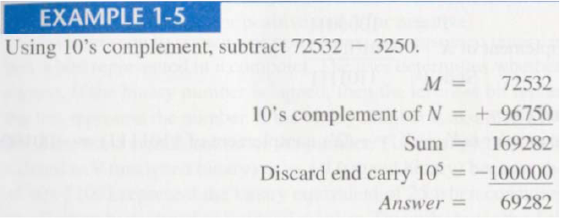
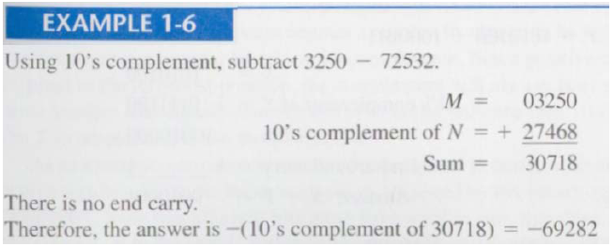
Subtraction with Complements

Slide 85
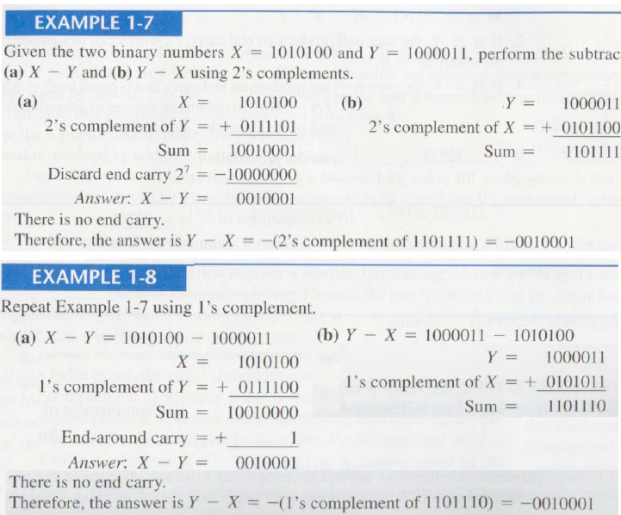
Subtraction with Complements

Slide 86
Signed Binary Numbers
Sign bit is the most significant bit represents the sign of the number
Two methods to represent negative number
1. Signed-magnitude system
0 for positive number and 1 for negative number
Example: 01001 can be 9 or +9
11001 can be 25 (unsigned) and -9 (signed)
This method of storing negative binary numbers does not work because:
Binary arithmetic won't work.
We must first know which storage mechanism the compiler of a particular language uses.

Slide 87
Signed Binary Numbers
2. Signed-complement system
A negative number is indicated by its complement
The signed-complement system can use either the
1’s or the
2’s complement,
but the 2’s complement is the most common.

Slide 88
Negative number in binary
Sign bit
00000101 = 5
10000101 = -5
8 bits number
For 4 bit numbers
0101 = 5
1101 = -5
0000 = 0
0001 = 1
0010 = 2
0011 = 3
0100 = 4
0101 = 5
0110 = 6
0111 = 7
1000 = -0
1001 = -1
1010 = -2
1011 = -3
1100 = -4
1101 = -5
1110 = -6
1111 = -7
What is the problem with this?

Slide 89
Problems
Sign bit
0000 vs. 1000 -> 0 and -0 ?!
Add issues:
5 + (-5) = ?
0101
+1101
10010 Ignoring the carry bit (0010) the result is 2. WIRED ☹
0000 = 0
0001 = 1
0010 = 2
0011 =3
0100 = 4
0101 = 5
0110 = 6
0111 = 7
1000 = -0
1001 = -1
1010 = -2
1011 = -3
1100 = -4
1101 = -5
1110 = -6
1111 = -7
What is the problem with this?

Slide 90
One’s complement
0000 = 0
0001 = 1
0010 = 2
0011 =3
0100 = 4
0101 = 5
0110 = 6
0111 = 7
1111 = -0
1110 = -1
1101 = -2
1100 = -3
1011 = -4
1010 = -5
1001 = -6
1000 = -7
+ 4 2 1
- 4 2 1
0000 = 0
0001 = 1
0010 = 2
0011 =3
0100 = 4
0101 = 5
0110 = 6
0111 = 7
1000 = -0
1001 = -1
1010 = -2
1011 = -3
1100 = -4
1101 = -5
1110 = -6
1111 = -7

Slide 91
One’s complement
0000 = 0
0001 = 1
0010 = 2
0011 =3
0100 = 4
0101 = 5
0110 = 6
0111 = 7
1111 = -0
1110 = -1
1101 = -2
1100 = -3
1011 = -4
1010 = -5
1001 = -6
1000 = -7
5 + (-5) = ?
0101
+1010
1111 and this is negative zero that is closer, right ☺

Slide 92
One’s complement
0000 = 0
0001 = 1
0010 = 2
0011 =3
0100 = 4
0101 = 5
0110 = 6
0111 = 7
1111 = -0
1110 = -1
1101 = -2
1100 = -3
1011 = -4
1010 = -5
1001 = -6
1000 = -7
3 + (-3) = ?
0011
+1100
1111 and this is negative zero that is closer, right ☺
Solve the problem?
What if we tried different numbers?

Slide 93
One’s complement
0000 = 0
0001 = 1
0010 = 2
0011 =3
0100 = 4
0101 = 5
0110 = 6
0111 = 7
1111 = -0
1110 = -1
1101 = -2
1100 = -3
1011 = -4
1010 = -5
1001 = -6
1000 = -7
5 + (-3) = ?
0101
+1100
10001 Ignoring the carry, the result is 0001. not correct but it is close right? ☺

Slide 94
One’s complement
0000 = 0
0001 = 1
0010 = 2
0011 =3
0100 = 4
0101 = 5
0110 = 6
0111 = 7
1111 = -0
1110 = -1
1101 = -2
1100 = -3
1011 = -4
1010 = -5
1001 = -6
1000 = -7
6 + (-2) = ?
0110
+1101
10011 Ignoring the carry, the result is 0011. not exactly correct but close right? ☺

Slide 95
One’s complement
0000 = 0
0001 = 1
0010 = 2
0011 =3
0100 = 4
0101 = 5
0110 = 6
0111 = 7
1111 = -0
1110 = -1
1101 = -2
1100 = -3
1011 = -4
1010 = -5
1001 = -6
1000 = -7
5 + (-5) = -0
3 + (-3) = -0
5 + (-3) = 1
6 + (-2) = 3
What did we observe here?

Slide 96
One’s complement
0000 = 0
0001 = 1
0010 = 2
0011 =3
0100 = 4
0101 = 5
0110 = 6
0111 = 7
1111 = -0
1110 = -1
1101 = -2
1100 = -3
1011 = -4
1010 = -5
1001 = -6
1000 = -7
What did we observe here?
5 + (-5) = -0
3 + (-3) = -0
5 + (-3) = 1 +1
6 + (-2) = 3 +1
So, one’s complements which flipping bits will solve the problem partially and the results close to correct. How to solve the issue?

Slide 97
Two’s complement
0000 = 0
0001 = 1
0010 = 2
0011 =3
0100 = 4
0101 = 5
0110 = 6
0111 = 7
------------
1111 = -1
1110 = -2
1101 = -3
1100 = -4
1011 = -5
1010 = -6
1001 = -7
5 + (-5) = ?
0101
+1011
10000 and ignoring the carry, the result is 0000 ☺
3 + (-3) = ?
0011
+1101
5 + (-3) = ?
0101
+1101
6 + (-2) = ?
0110
+1110
10000
10010
10100
So the two’s complements works pretty well !

Slide 98
Steps to represents negative numbers
Step 1: Write the absolute value of the given number in binary form. Prefix this number with 0 indicate that it is positive.
Step 2: Take the complement of each bit by changing zeroes to ones and ones to zero.
Step 3: Add 1 to your result. This is the two’s complement representation of the negative integer.
EXAMPLE: Find the two’s complement of -17 (4 bit representation)
Step 1: 1710 = 0001 00012
Step 2: Take the complement: 1110 1110
Step 3: Add 1: 1110 1110 + 1 = 1110 1111.
Thus the two’s complement for -17 is 111011112

Slide 99
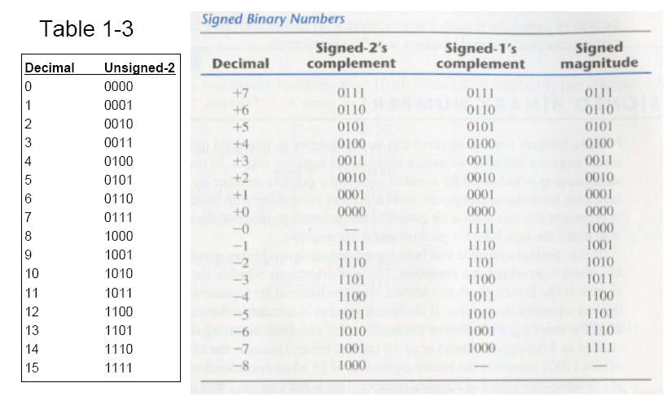
Signed Binary Numbers

Slide 100
Arithmetic Addition
The addition of two signed binary numbers with negative numbers represented in signed-2’s-complement form is obtained from the addition of the two numbers, including their sign bits. A carry out of the sign-bit position is discarded.
See the examples in the next slide.
In order to obtain a correct answer, we must ensure that the result has a sufficient number of bits to accommodate the sum.
If we start with two n-bit numbers and the sum occupies n + 1 bits, we say that an overflow occurs.

Slide 101
Arithmetic Addition (Examples)
+6 00000110
+13 00001101
+19 00010011
-6 11111010
+13 00001101
+7 00000111
+6 00000110
-13 11110011
-7 11111001
-6 11111010
-13 11110011
-19 11101101

Slide 102
Binary Codes
Binary Coded Decimal (BCD 4-bit)
(4267)₁₀ = (0100 0010 0110 0111)_{BCD}
(9803)₁₀ = (1001 1000 0000 0011)_{BCD}
The following configurations: 1010, 1011, 1100, 1101, 1110, and 1111 are not authorized in BCD
Do NOT mix up conversion of a decimal number to a binary number with coding a decimal number with a BINARY CODE.
13₁₀ = 1101₂ (conversion) ⇔ 0001 | 0011 (coding)
BCD Addition
Get the binary sum, if sum > 9, add 6 to the sum
Obtain the correct BCD digit sum and a carry

Slide 103
Why BCD
Encodes each digits of a decimal number as a sequence of bits
Results in less data loss for floating-point calculations, but requires more complex circuitry and greater storage than other systems.

Slide 104
Examples from the note

Slide 105
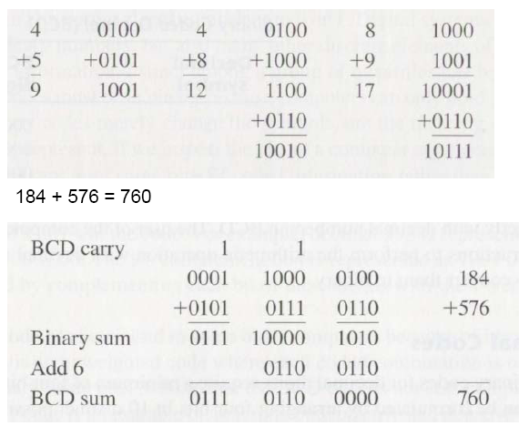
BCD Addition

Slide 106
Weighted Codes
The BCD code is the 8,4,2,1 code, and 8, 4, 2, and 1 are weights; so, BCD is a weighted code
Decimal
8,4,2,1
Excess3
8,4,
-
2,
-
1
Gray
0
0000
0011
0000
0000
1
0001
0100
0111
0100
2
0010
0101
0110
0101
3
0011
0110
0101
0111
4
0100
0111
0100
0110
5
0101
1000
1011
0010
6
0110
1001
1010
0011
7
0111
1010
1001
0001
8
1000
1011
1000
1001
9
1001
1
100
1111
1000

Slide 107
Conclusion
Most used number systems are : decimal, binary and hexadecimal.
Computers store data in the form of bits, bytes, and words using the binary numbering system.
Hexadecimal numbers are formed using four-bit groups.
Signed integers can be stored in one’s complement, two’s complement, or signed magnitude representation.

